Slide 1

E-COMMERCE
Presentation by Group 4
AJIT KAPARDAR
CHETAN
RAKSHAN M
KABERU KARTHIK KUMAR
MOHAMMED SHIBLY NAZEER

Slide 2
Overview
This presentation provides an analysis of E-Commerce operations using data insights.
E-commerce data provides valuable insights into customer behavior, product performance, and market trends across various regions and platforms.
The goal is to understand customer purchasing patterns, optimize operational efficiency, and identify key business growth opportunities.

Slide 3
Challenges Faced During Data cleaning
Inconsistent Formatting:
  Standardized date formats (e.g., order date, delivery date) and normalized column names.
  Removed currency symbols (₹, $, etc.) and percentage signs from discount fields for clarity.
Missing Values:
  Some records had missing data for key fields such as customer ID, product ID, or purchase amount.
  Applied imputation techniques or removed incomplete records based on impact.
Incorrect Data Types:
  Sales amount, quantity, and discount values were sometimes stored as text instead of numeric format.
  Converted these to appropriate data types for accurate analysis and calculations.

Slide 4
Key Insights – E-commerce
1.Customer Behavior Patterns
  Peak shopping times observed during weekends and festive seasons.
  Repeat customers contribute to a significant portion of total revenue.
2.Top-Performing Products
  A small percentage of products (e.g., top 20%) generate the majority of sales.
  High-performing categories include electronics, fashion, and home essentials.
3.Sales and Revenue Trends
  Consistent month-over-month growth in online sales.
  Flash sales and discount campaigns lead to noticeable spikes in revenue.
4.Cart Abandonment Rates
  High abandonment rate (~60–70%) observed during checkout.
  Common causes include high shipping costs and complex checkout process.

Slide 5
Key Insights – E-commerce
5.Geographical Trends
  Metro cities contribute the highest to sales, while Tier-2 and Tier-3 cities show growing interest.
  Regional preferences influence product demand.
6.Marketing Effectiveness
  Email and social media campaigns show high engagement but varied conversion rates.
  Personalized recommendations lead to better click-through and purchase rates.
7.Customer Segmentation
  Identified high-value customers based on frequency and amount of purchases.
  Segmentation helps in targeted marketing and personalized offers.

Slide 6
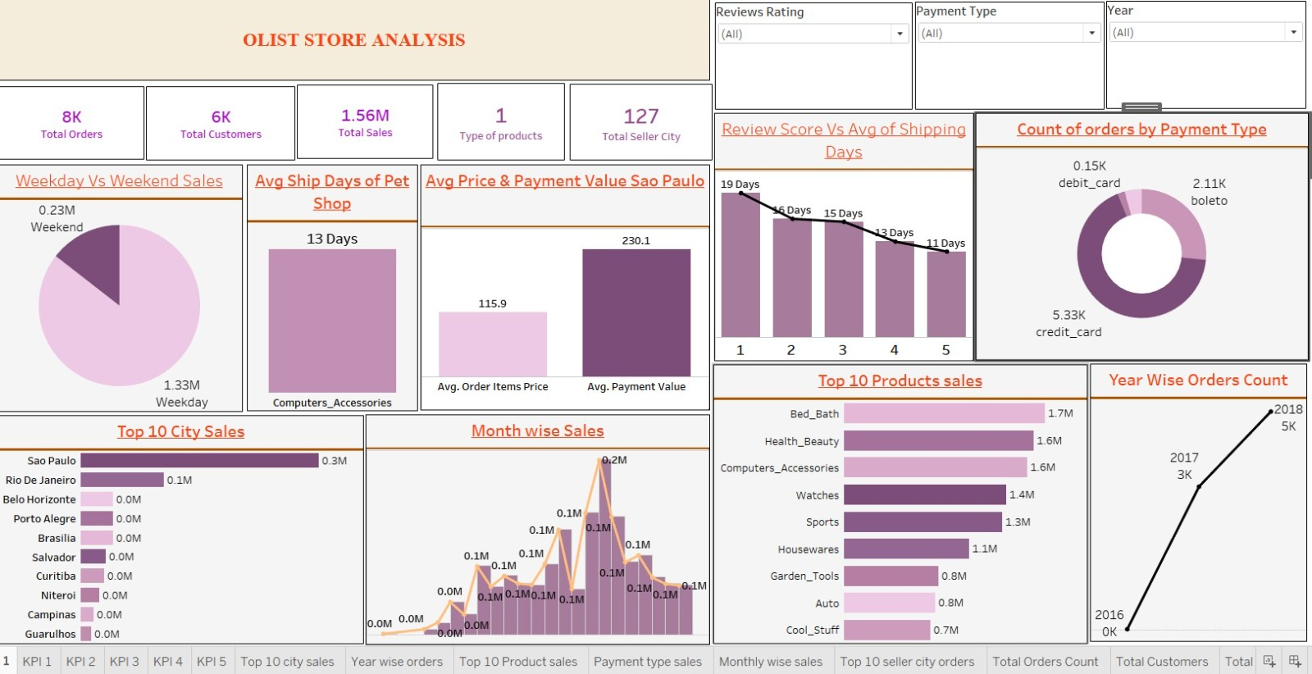

Slide 7
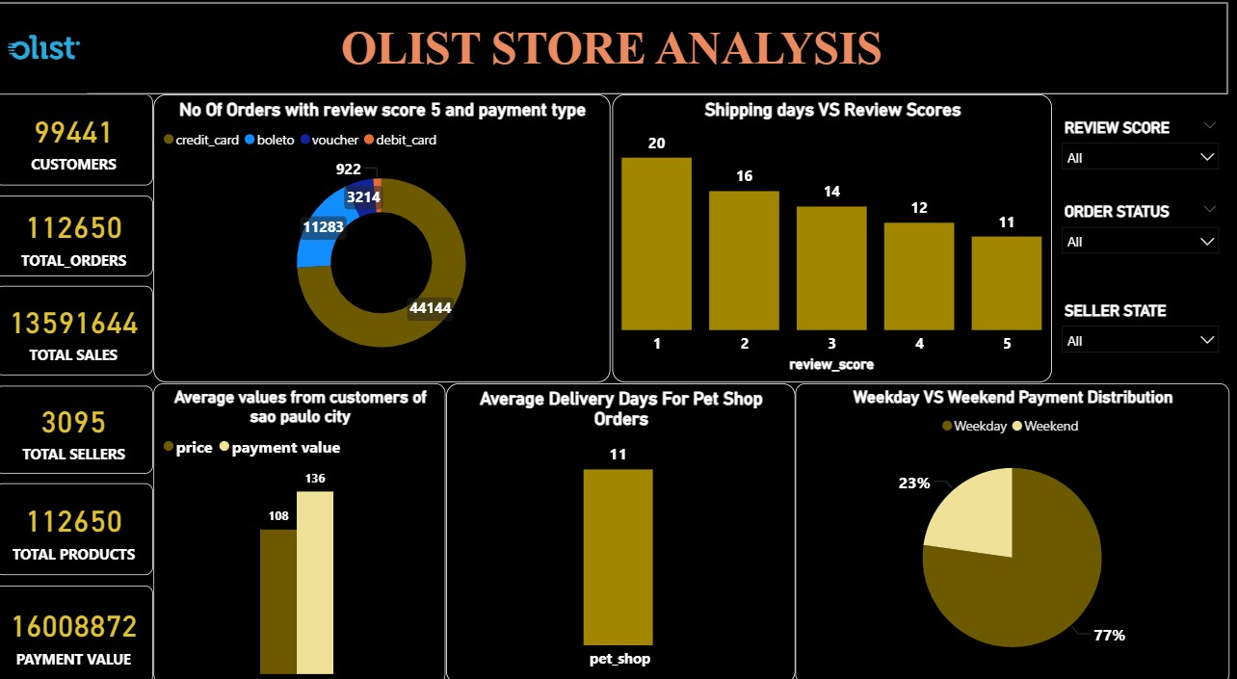

Slide 8
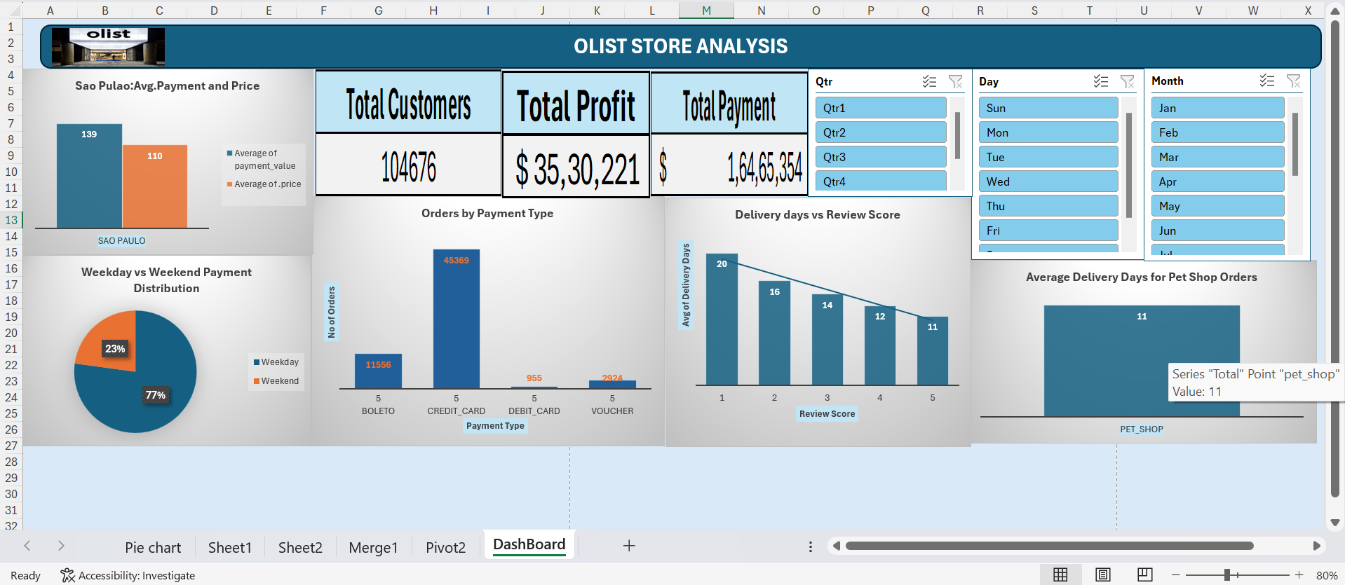

Slide 9
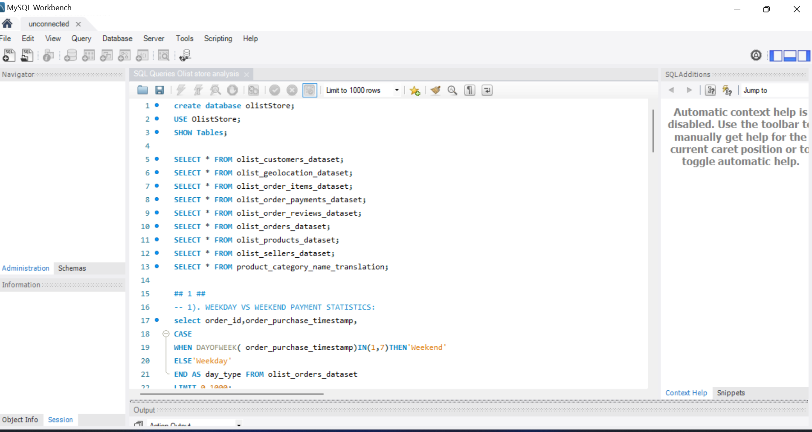

Slide 10
Conclusion & Recommendations
Key Takeaways
Recommendations
Urban regions drive the majority of sales, with metro cities contributing significantly more than rural areas.
Sales volumes peak during festive seasons and weekends, indicating strong seasonal buying patterns.
Top-selling products account for a majority of revenue, while slow-moving inventory adds to holding costs.
High cart abandonment rates highlight friction in the checkout process and the impact of shipping costs or delays.
Expand High-Demand Product Lines: Increase inventory and visibility of best-selling products to meet consumer demand.
Enhance Weekend & Festive Engagement: Launch targeted promotions and discounts during peak shopping periods.
Target Emerging Markets: Focus marketing and logistics on Tier-2/Tier-3 cities to unlock new customer bases.

Slide 11
Conclusion
E-commerce business insights highlight key opportunities to boost market performance and operational efficiency.
A data-driven approach suggests focusing on expanding high-demand product categories, optimizing pricing and discount strategies, and enhancing weekend and festive season sales engagement.
Additionally, benchmarking against top-performing competitors and targeting emerging customer segments can drive sustainable growth.
By implementing these strategic decisions, the e-commerce platform can strengthen its competitive position and maximize profitability in the online retail market.

Slide 12
Thank You

